Slide 1
CSE299: Junior Project Design Design & Development of AGB
Faculty Initial: ITN
Semester: Summer’19
Section: 12
Group 04
Submitted By
Anwar Shadaab (1611383042)
M Saydur Rahman (1520490642)
Kazi Sadia Kabir (1420174042)

Slide 2
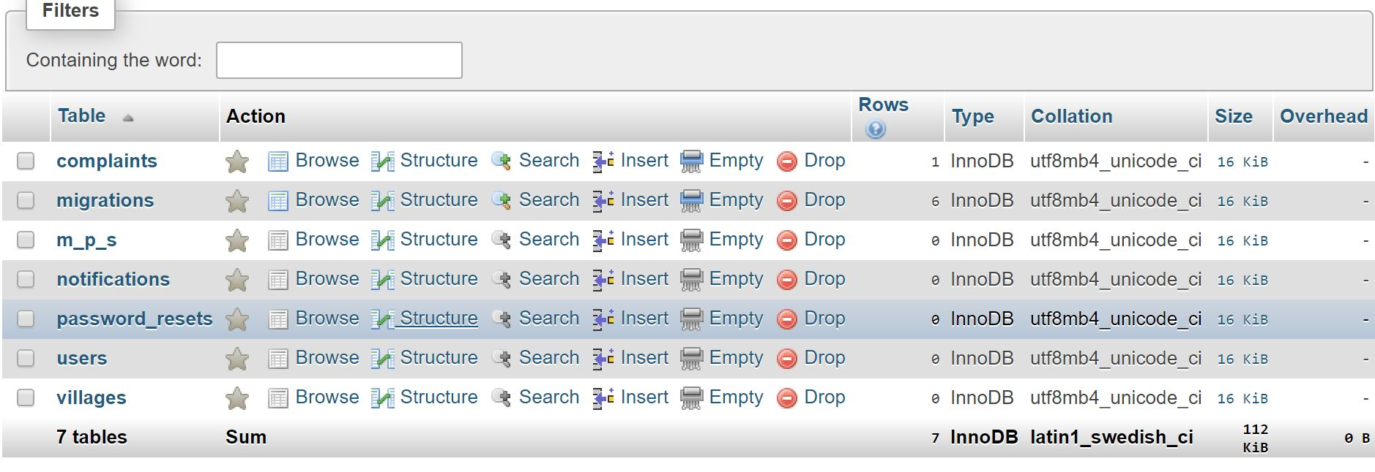
Database

Slide 3
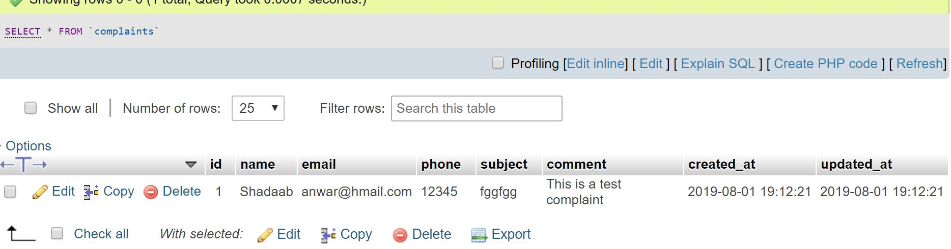
Database (Complaint)

Slide 4
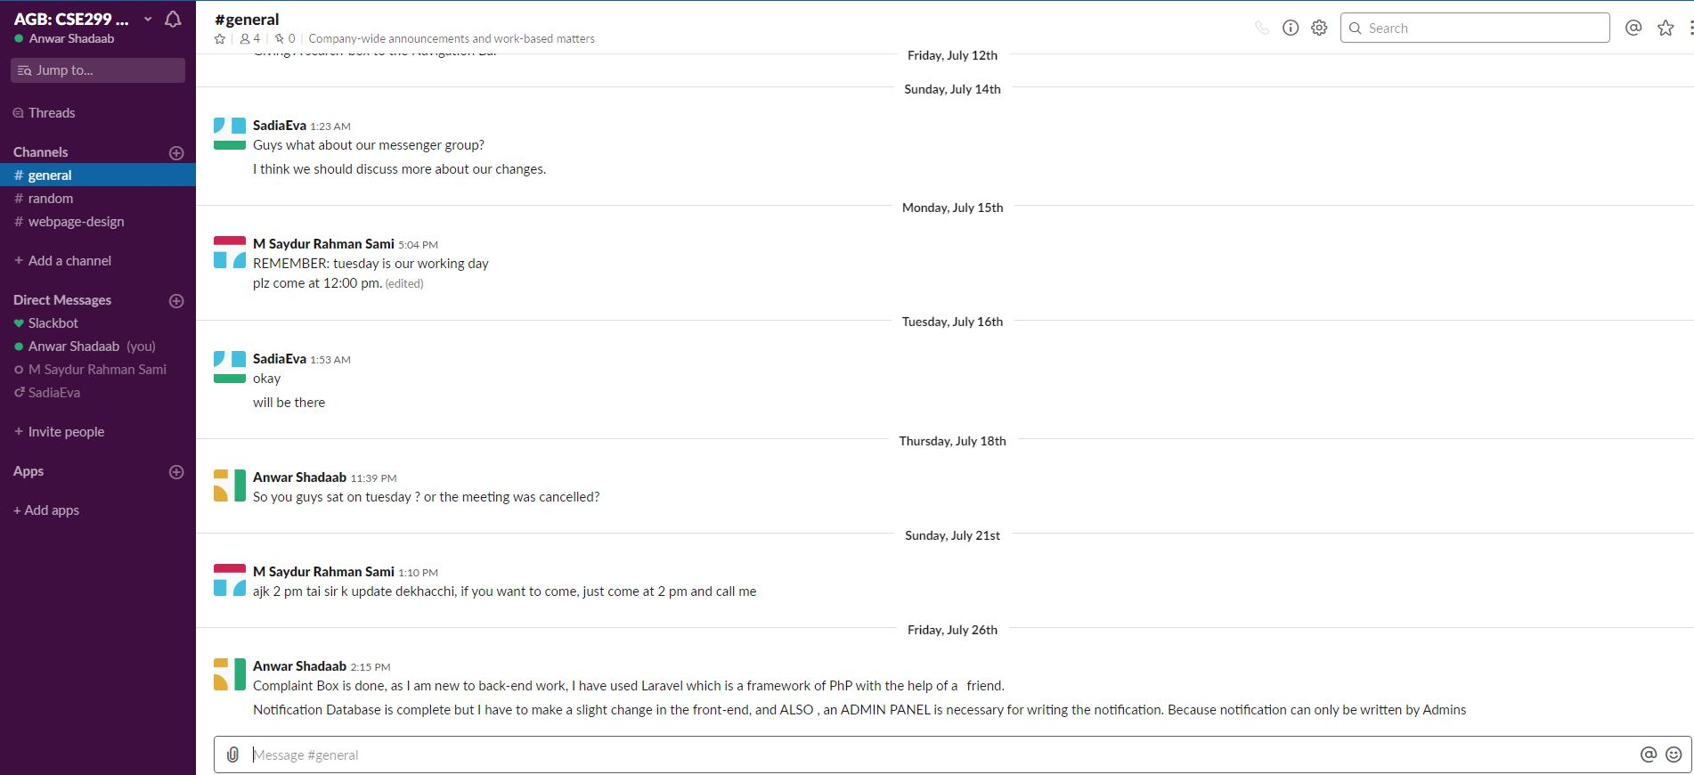
Slack

Slide 5
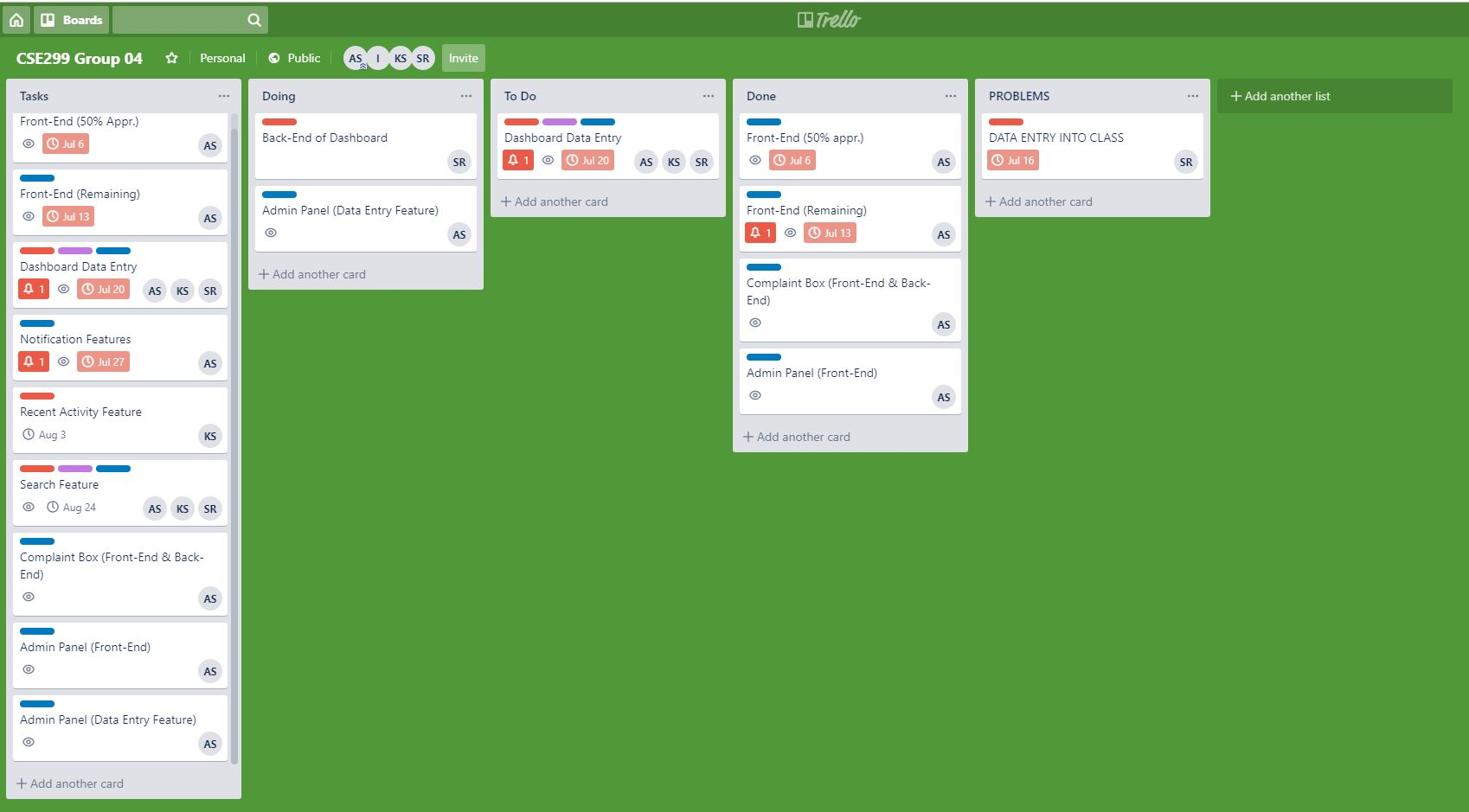
Trello

Slide 6
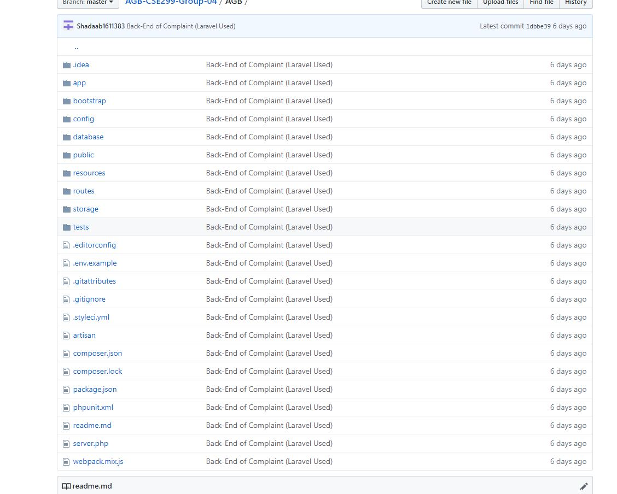
GitHub

